Slide 1



Revolutionizing Urban Mobility
The Rise of Urban Mobile Vehicles

Slide 2
TABLE OF CONTENTS
01
02
03
04
Introduction
Need for Data Science
Data Scientist: Roles & Routines
Tools & Technologies
05
06
Company Data
Courses to consider

Slide 3
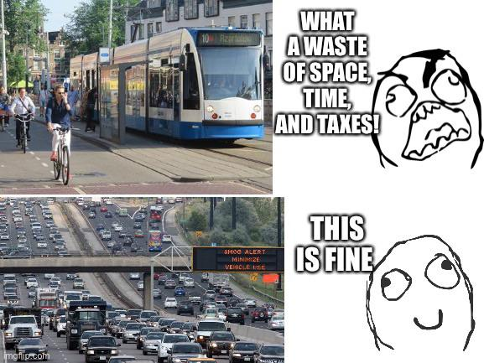
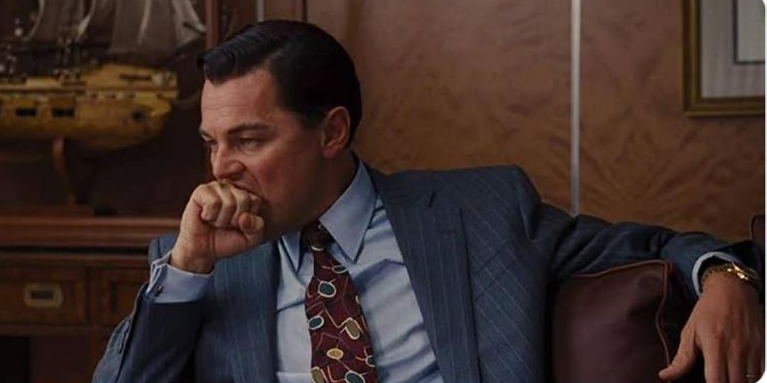
Introduction
01
Traffic congestion in major cities like New York and Los Angeles has become a daily frustration for commuters
Can You Actually Ditch Your Car for an E-Bike? Maybe

Slide 4


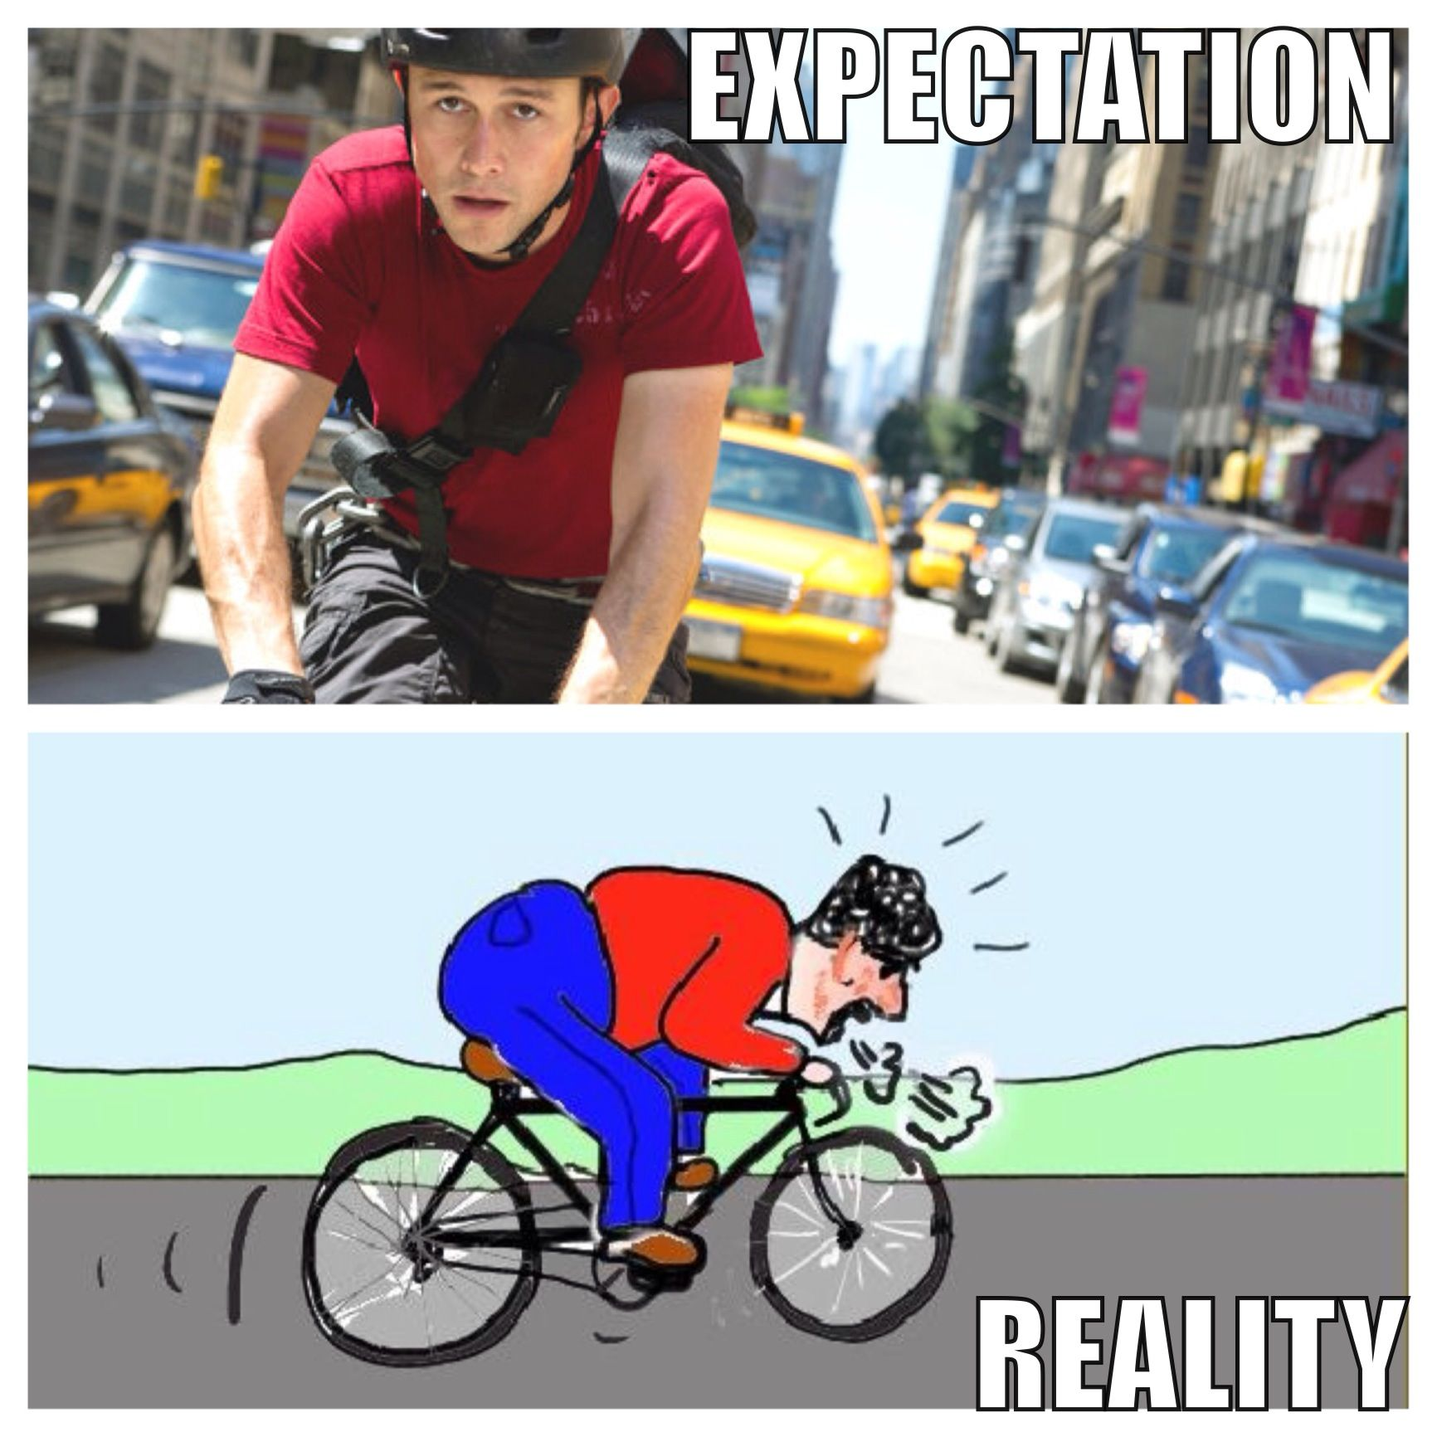
What’s Urban Mobility ?
Movement of people and goods within urban areas

Slide 5
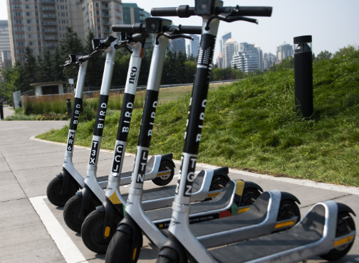
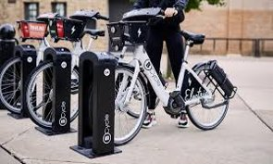
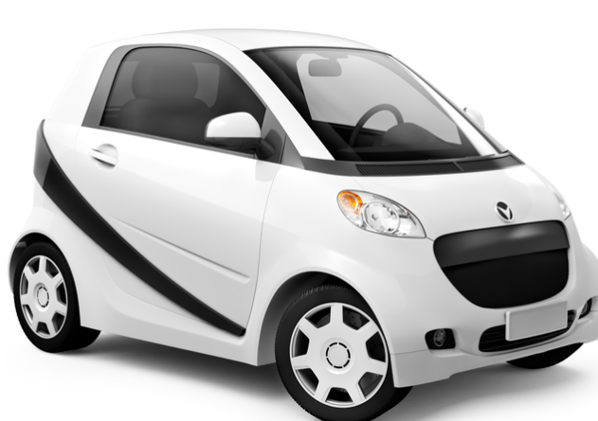
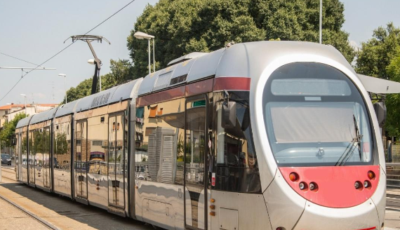
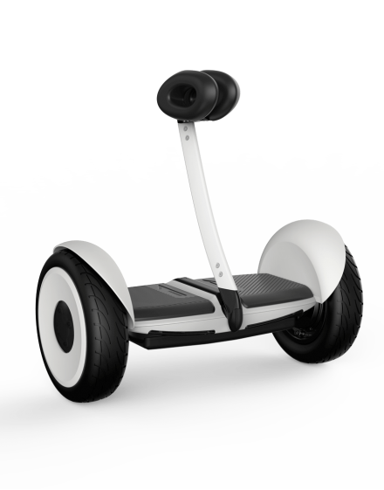
Types of Urban Mobile Vehicles
E-bikes, from Lime,
Bird Companies
E-Scooters, E-Skateboards,
E-Hoverboards, E-Unicycle
E-Go-Karts, Public Transit Vehicles (e.g., buses, trams)
Ride-Sharing Services, Microcars

Slide 6

“It's easy to lie with statistics. Its hard to tell the truth without statistics”
—ANDREJS DUNKELS
02
Need for Data Science

Slide 7
Challenges
Efficiency & Maintainability
Battery life
Capacity degradation
Health checks
High initial costs
Regular maintanance
Charging Infrastructure
Theft & Location tracking
Live GPS
Slow charging speeds
No charging point availability
Safety
Capacity degradation
Health checks

Slide 8

03
Working with data
Roles & Routines

Slide 9
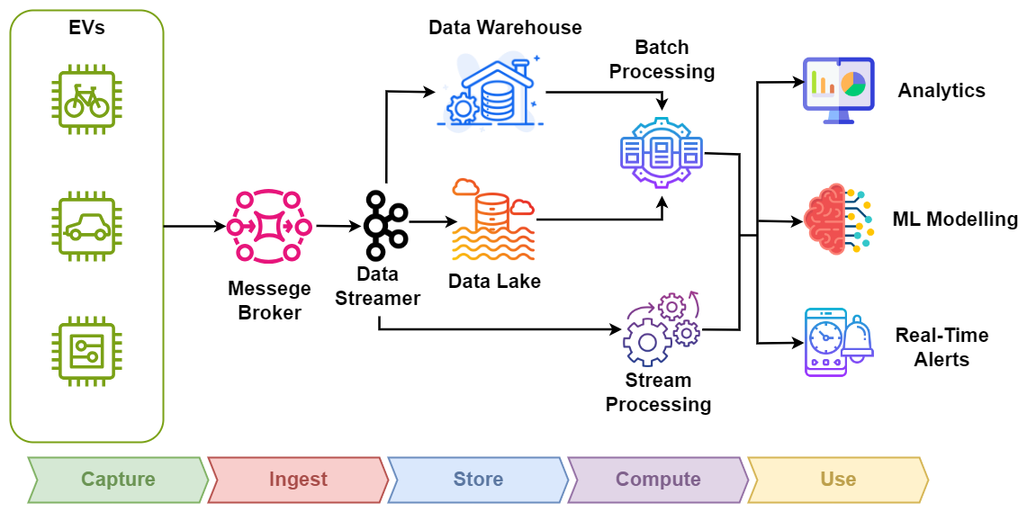
Dataflow pipeline

Slide 10

Roles & Responsibilities
Data Engineer:
Building data pipelines
Batch & Stream Processing
Data Scientist:
ML model Building
Predictive Analytics
Data Analyst:
Building BI Dashboards

Slide 11
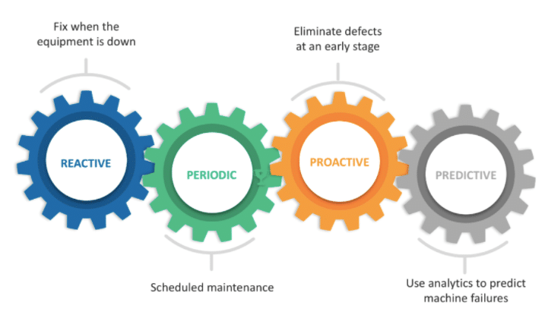

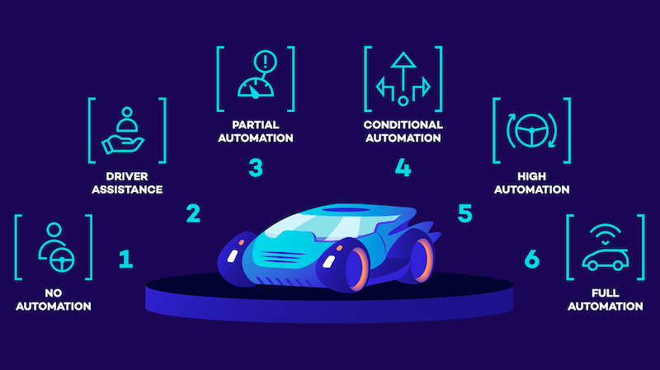
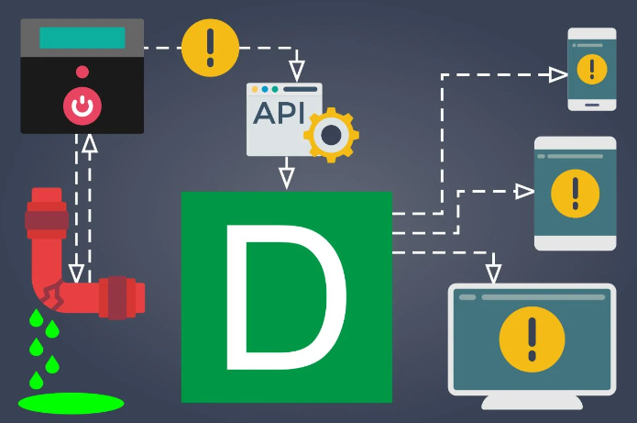
Applications in field
Predictive Analysis
Analytics
Automation using models
Realtime Event Processing

Slide 12
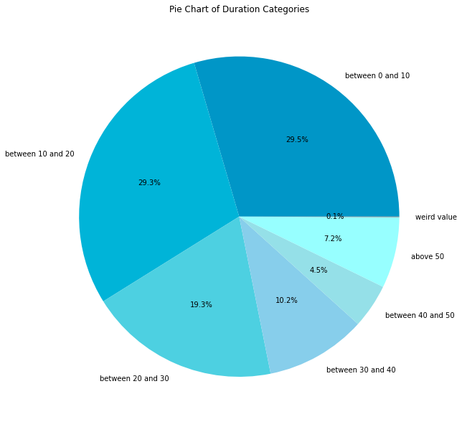
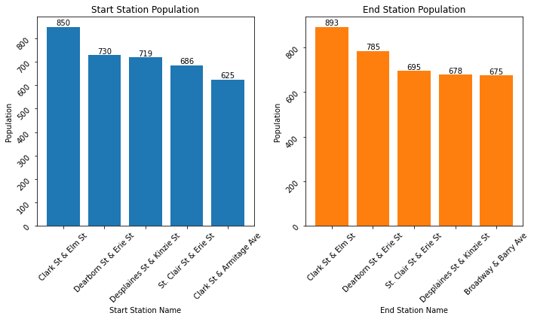
A Glimpse of our data

Slide 13

04
Tools & Technologies

Slide 14
Tools & Technologies
Python & ML Libraries
Cloud Platforms
Streaming & Messaging
Keras & Tensorflow
Huggingface
Matplotlib & Seaborn
Pandas & Numpy
AWS
Azure
Apache Kafka
MQTT protocol
Google pubsub
Data Lake & Warehouses
Processing Tools
Visualization
Apache Delta Lake & Iceberg
AWS Redshift
Azure Synapse
GCP Big query
Snowflake
Apache spark
Apache flink
Elastisearch
Apache superset
Grafana / Kibana
Tablue
PowerBI

Slide 15



Companies
05
Data Collection & Usage

Slide 16
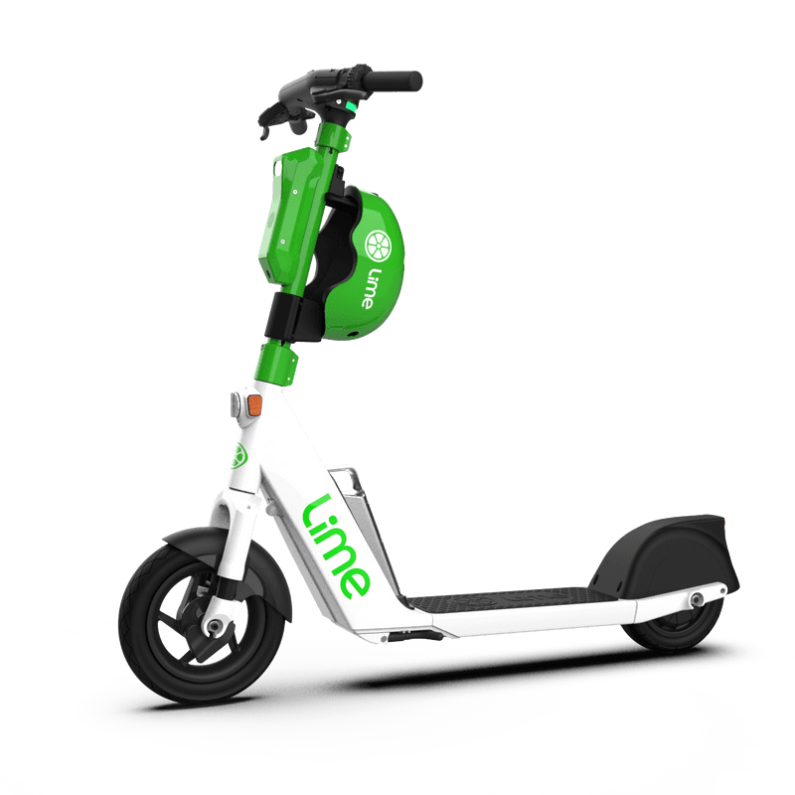
Lime Data Collection
GPS Data
Maintenance Alerts
Collect scooter location and movements.
Track scooter availability to meet demand.
Detect issues and maintenance needs.
Address flat tires, mechanical problems, and safety concerns.
Battery Status
Monitor battery levels.
Ensure scooters are charged and ready for use.

Slide 17
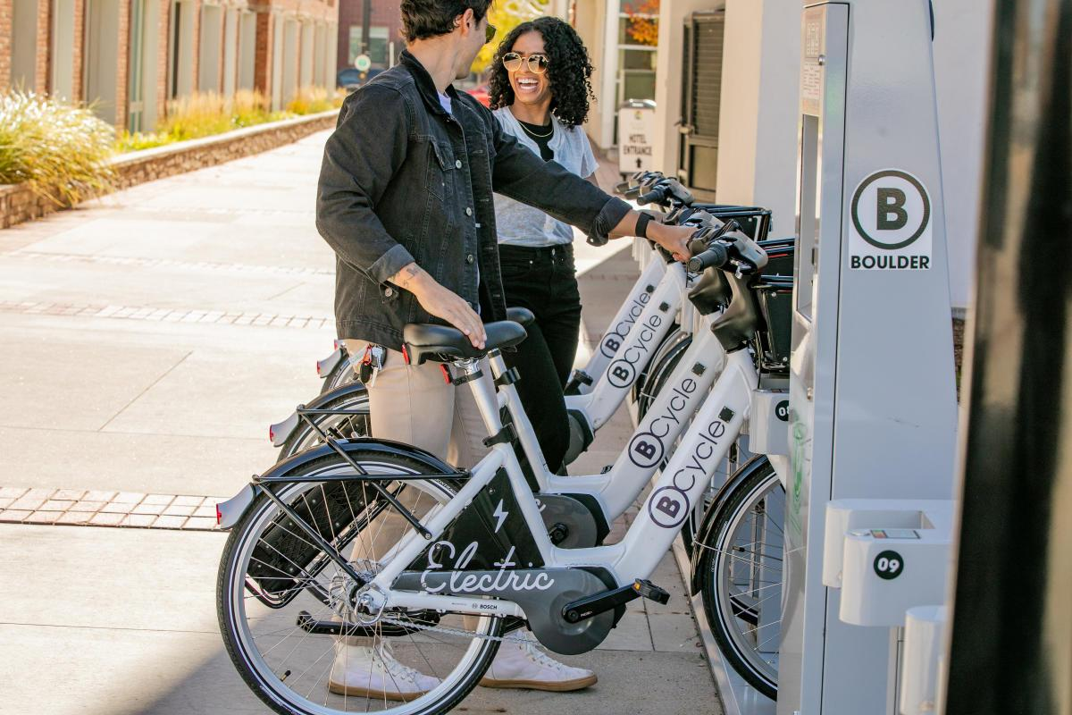
BCycle Data Collection
Bike Usage
User Feedback
Collect daily usage by station.
Expand/reduce existing stations to meet locational demand.
Supply periodic surveys via app and email.
Incorporate popular suggestions to increase quality of service.
App Usage
Track how users interact with their mobile app.
Enhance user interface and app functionality.

Slide 18

Courses to Consider
06
Big Data Analytics (CSCI 6502)
Datacenter scale computing (CSCI 5253)
Deep Learning (CSCA 5642)
Data Mining (CSCI 5502)
Statistical methods and applications I (STAT 5000)
Sustainable Energy (ECEN 1500)

Slide 19


Ouch !
Is it finished ?
A Presentation by
Navya Prasad
Jagrati Chauhan
Srimedha
Pratheek
Krishna
Austin
Until next time.…
THANK YOU

